Slide 1
Class-loading Optimization
Use Static Imports
Optimize Classpath
ClassLoader Caching
Class Preloading (Class.forName)
Use the Bootstrap Classloader
Class Data Sharing (CDS)

Slide 2
Reducing Class Metadata Footprint
Remove Unused Classes
Optimize Class Design
String Interning
Avoid Excessive Reflection
Classfile Compression
-XX: UseCompressedClassPointers
Metaspace Size Compression
-XX: MaxMetaspaceSize

Slide 3
ACHIEVING Low-Latency : high-througHput
Use Latest Java Version
Garbage Collection (GC) Tuning
Utilize Thread Pools
Caching
I/O Optimization
Memory Efficiency
Testing and Benchmarking
Network Optimization

Slide 4
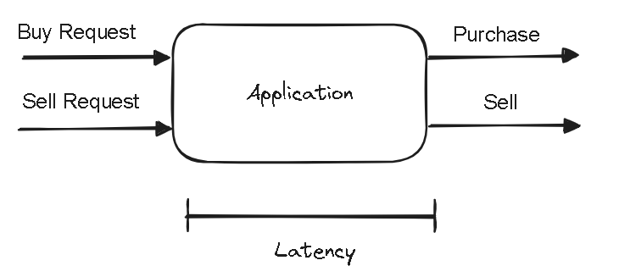
Latency: Measured in units of time. Speed at transactions. The time to complete a task.
Throughput: The amount of tasks completed in a given period of time. Measured in task/time unit.

Slide 5
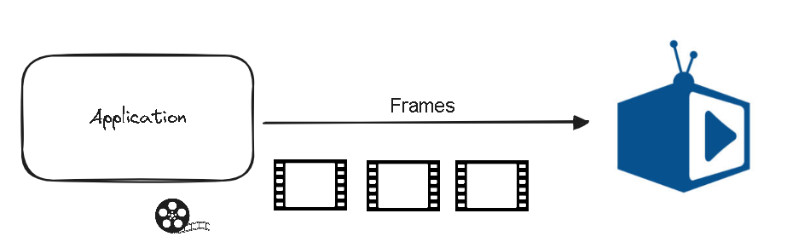
Video Player: Video is to be played at 30 frames per second is shown at 1000 frames per second.
The use will not see anything. Correct and accurate and not jittery image. Consideration should be accuracy and precision of frame rate.

Slide 6
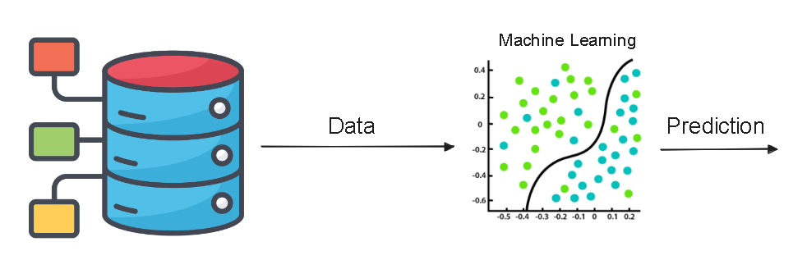
Prediction basis large volume of data. More data better the prediction. Throughput is important here.

Slide 7
Latency
Theoretical reduction of latency by N = Performance improvement by a factor of N
N=?
How many subtasks/threads to break the original task?
Does breaking original task and aggregating results come for free?
Can we break any task into subtasks?

Slide 8
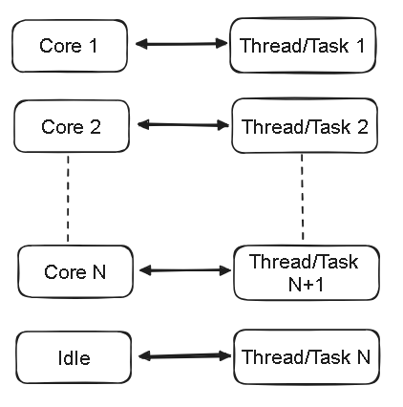
Adding an additional task would be counterproductive and increase the latency.
N=?

Slide 9
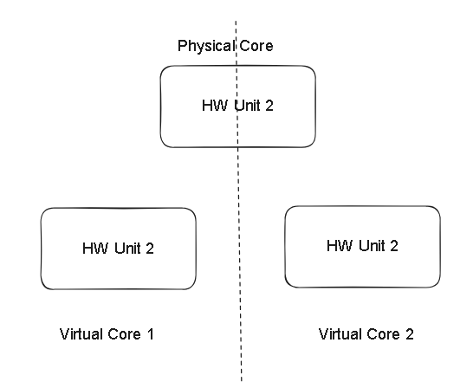
N=? - Notes
#threads #cores is optimal only if all threads are runnable and can run without interruption (no IO/ blocking calls/ sleep etc)
The assumption is nothing else is running that consumes a lot of CPU
Hyperthreading – Virtual Cores VS Physical Cores

Slide 10
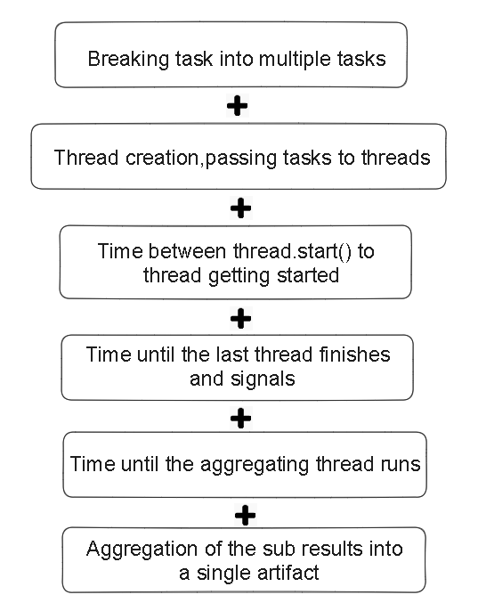
Inherent cost of parallelization and aggregation

Slide 11
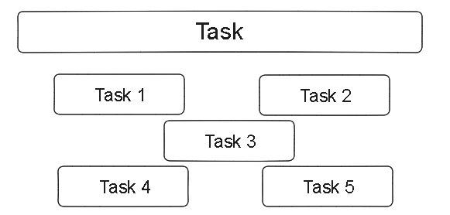
Partially parallelizable, Partially sequential

Slide 12
Summary
Performance can be defined in many ways depending on the use case
Multithreaded Applications performance criteria
Latency
Throughput
Latency reduction by breaking the task into multiple, and running in parallel

Slide 13
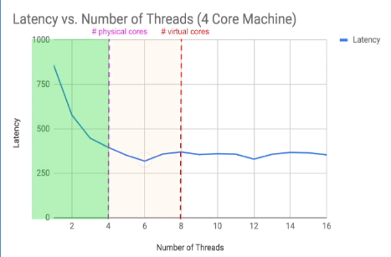
Performance analysis- Latency vs #threads

Slide 14
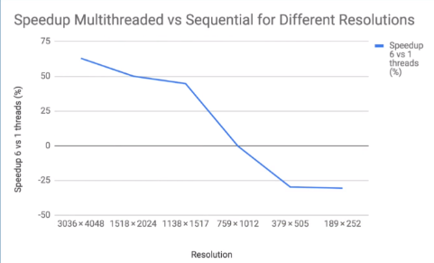
Performance analysis

Slide 15
Summary
We can get a speed up if we partition a problem into multiple sub-problems
More threads than cores is counterproductive
There is inherent cost for running an algorithm by multiple threads

Slide 16
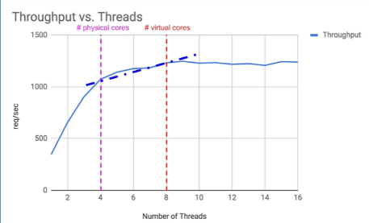
Performance analysis

Slide 17
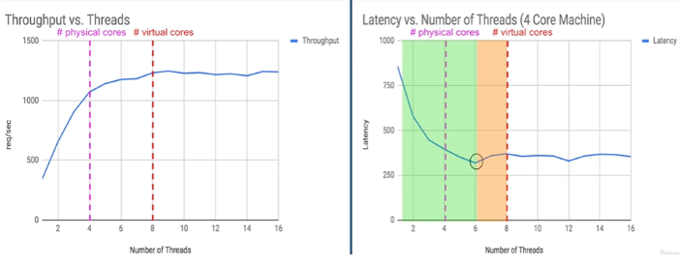
Performance analysis

Slide 18
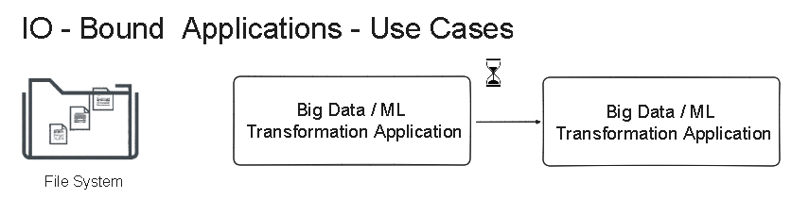
Blocking io
CPU is not involved in IO
IO Bound web appplication .. #threads

Slide 19
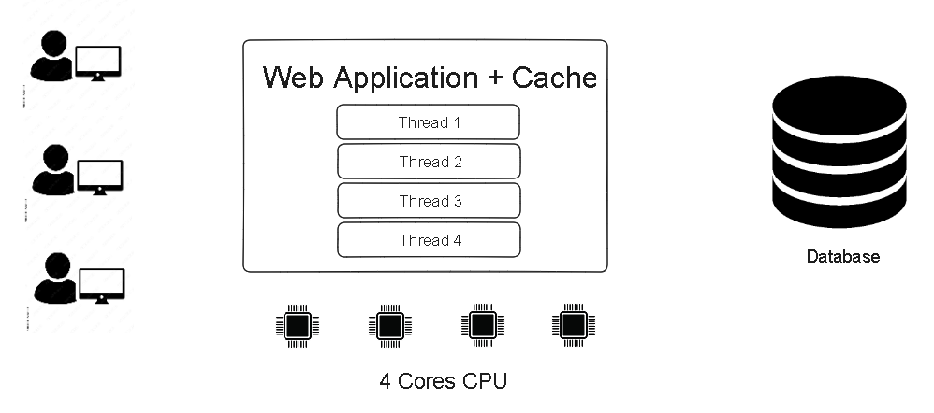
Scenario-2 multithreaded web application

Slide 20
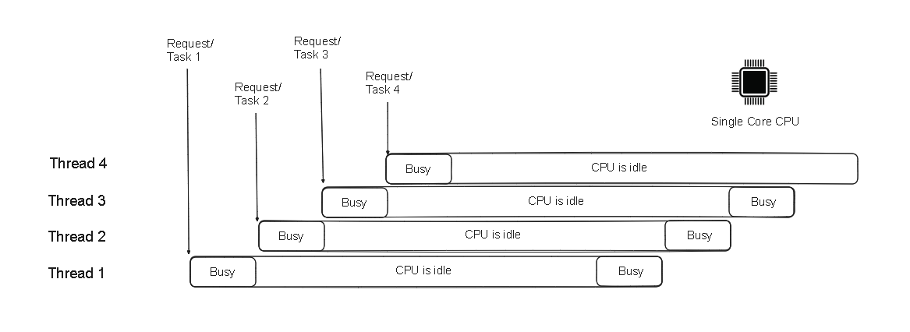
Thread-per-task threading model

Slide 21
Threads-per-task model - analysis
Issues
Threads are expensive
Number of threads we can create is limited
Threads consume stack memory and other resources
Too many threads - our application will crash
Too few threads - Lower throughput and CPU utilization

Slide 22
Threads-per-task model - analysis
Issues –Continued
Price of context switches:
OS is trying to fully utilize the CPU
As soon as there's a blocking call, the OS unschedules that thread
Too many threads and frequent blocking calls leads to the CPU being busy running the OS code

Slide 23
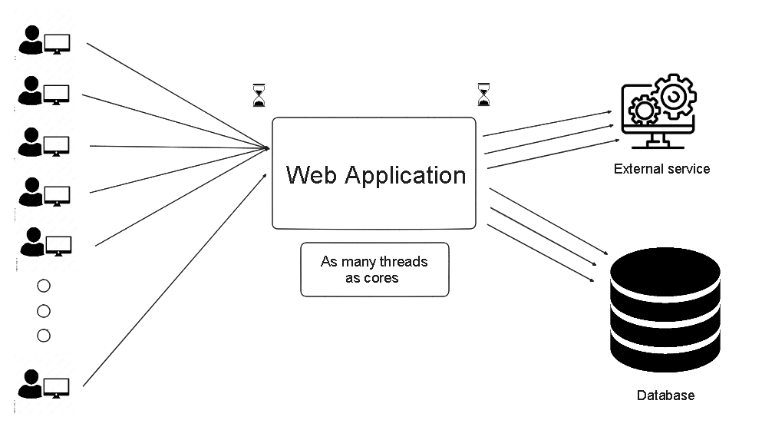
Non blocking io – no inversion of control

Slide 24
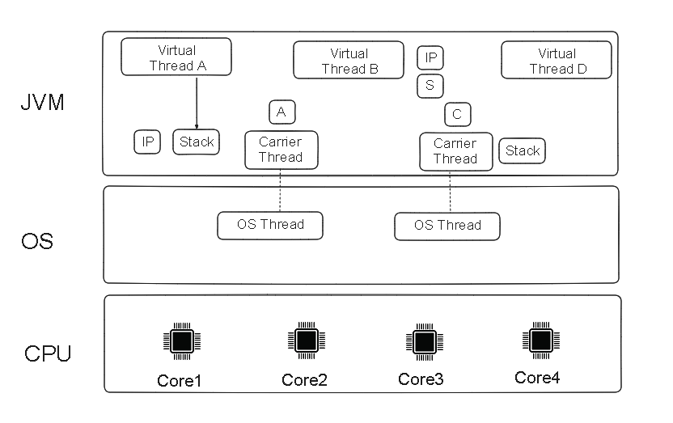
How do virtual threads run?

Slide 25
Summary
How I/O Operations Work
The CPU is not involved in long I/O operations
Explored a scenario of an I/O-bound web application
Discovered that with tasks involving blocking calls #threads=#cores doesn't work
Blocking calls impact the performance of the entire application

Slide 26
Methodologies
Performance Baseline:
Identify Bottlenecks
Prioritize Issues
Benchmarking
Iterative Testing
Incremental Changes:

Slide 27
Methodologies
Database Optimization
Caching Strategies
Concurrency and Parallelism
Code Profiling
Resource Utilization
Content Delivery Networks (CDN)

Slide 28
Performance Monitoring
Load Balancing
Response Time Analysis
Error Handling
Code Optimization
Caching Strategies
Database Indexing

Slide 29
Performance Monitoring
Compression Techniques
Resource Cleanup
Performance Budgets
Documentation
User Feedback

Slide 30
Distributed systems
Latency and Network Optimization
Load Balancing
Data Storage and Retrieval
Consistency and Replication
Concurrency and Parallelism
Failure Handling
Monitoring and Diagnostics

Slide 31
Distributed systems
Asynchronous Processing
Resource Management
Optimizing Transactions
Security Considerations
Testing and Simulation
Documentation and Knowledge Sharing
Scalability

Slide 32
Case Study: Facebook's Memcached Optimization
Problem: Facebook heavily relies on Memcached for caching frequently accessed data. They faced challenges with cache stampedes, where a large number of requests would simultaneously try to fetch an expired key, causing unnecessary load on the database.
Solution: Facebook implemented a technique called "lazy loading," where a single thread refreshes the cache, and other threads continue serving stale data until the refresh is complete. This reduced the load on the database during cache refreshes.

Slide 33
Case Study: Pinterest's MySQL Optimization
Problem: Pinterest experienced performance issues with MySQL due to the high volume of queries. Certain queries were not performing well, impacting the overall user experience.
Solution: Pinterest optimized their MySQL queries by re-writing some queries, creating appropriate indexes, and using caching techniques. They also implemented sharding to distribute the database load across multiple instances.

Slide 34
Case Study: Netflix's Chaos Engineering
Problem: Ensuring high availability and performance at scale is critical for Netflix. They needed a way to proactively identify and address weaknesses in their distributed system architecture.
Solution: Netflix introduced Chaos Monkey, a tool for deliberately introducing failures into their production environment. This allowed them to identify vulnerabilities and improve system resilience. Chaos Engineering became a best practice for testing and improving system reliability.

